Slide 1




VISUAL BASIC.NET
INTRODUCTION

Slide 2

What Is Visual Basic .NET?
Visual Basic .NET is the next generation of Visual Basic, but it is also a significant departure from previous generations. Experienced Visual Basic 6 developers will feel comfortable with Visual Basic .NET code and will recognize most of its constructs. These include such additions as a Class keyword for defining classes and an Inherits keyword for object inheritance, among others.

Slide 3
hello, world
This is the favorite programming example, translated to Visual Basic .NET:
Imports System
Public Module Hello
Public Sub Main( )
Console.WriteLine("hello, world")
End Sub
End Module

Slide 4
hello, world
This version of hello, world is a console application -- it displays its output in a Windows command prompt window. To compile this program, enter it using any text editor, such as Windows's Notepad, save it in a file whose name ends with .vb, such as Hello.vb, and compile it from the Windows command line with this command:
vbc Hello.vb

Slide 5
hello, world
The command vbc invokes the Visual Basic .NET command-line compiler, which ships with the .NET Framework SDK, and instructs it to compile the file named in the command-line argument. Compiling Hello.vb generates the file Hello.exe. After compiling, type Hello at the command line to run your program. Figure shows the results of compiling and running this program.

Slide 6
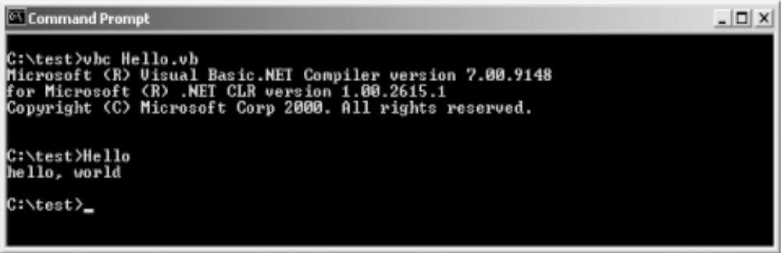
hello, world

Slide 7
hello, world
The command vbc invokes the Visual Basic .NET command-line compiler, which ships with the .NET Framework SDK, and instructs it to compile the file named in the command-line argument. Compiling Hello.vb generates the file Hello.exe. After compiling, type Hello at the command line to run your program. Figure shows the results of compiling and running this program.

Slide 8
hello, world
The purpose of standard modules in Visual Basic 6 was to hold code that was outside of any class definition. For example, global constants, global variables, and procedure libraries were often placed in standard modules. Standard modules in Visual Basic .NET serve a similar purpose and can be used
in much the same way. However, in Visual Basic .NET they define data types that cannot be instantiated and whose members are all static.

Slide 9
hello, world
The Main subroutine is the entry point for the application. When the Visual Basic .NET compiler is invoked, it looks for a subroutine named Main in one of the classes or standard modules exposed by the application. If Main is declared in a class rather than in a standard module, the subroutine must be declared with the Shared modifier. This modifier indicates that the class does not need to be instantiated for the subroutine to be invoked.

Slide 10
hello, world
Console.WriteLine("hello, world")
This code invokes the Console class's WriteLine method, which outputs the argument to the console. The WriteLine method is defined as a shared (also known as a static) method. Shared methods don't require an object instance in order to be invoked; nonshared methods do. Shared methods are invoked by qualifying them with their class name (in this case, Console).

Slide 11
hello, world
Imports System
Public Class Hello
Public Shared Sub Main( )
Console.WriteLine("hello, world")
End Sub
End Class

Slide 12
hello, world
Here is a program that uses a class instead of a standard module to house its Main subroutine. Note that Main is declared with the Shared modifier. It is compiled and run in the same way as the standard module example, and it produces the same output. There is no technical reason to choose one implementation over the other.

Slide 13
Hello, Windows
Imports System
Imports System.Drawing
Imports System.Windows.Forms
Public Class HelloWindows
Inherits Form
Private lblHelloWindows As Label
Public Shared Sub Main( )
Application.Run(New HelloWindows( ))
End Sub

Slide 14
Hello, Windows
Public Sub New( )
lblHelloWindows = New Label( )
With lblHelloWindows
.Location = New Point(37, 31)
.Size = New Size(392, 64)
.Font = New Font("Arial", 36)
.Text = "Hello, Windows!"
.TabIndex = 0
.TextAlign = ContentAlignment.TopCenter
End With

Slide 15
Hello, Windows
Me.Text = "Programming Visual Basic .NET"
AutoScaleBaseSize = New Size(5, 13)
ClientSize = New Size(466, 127)
Controls.Add(lblHelloWindows)
End Sub
End Class

Slide 16
Hello, Windows
Public Sub New( )
Like Main, New has special meaning to the Visual Basic .NET compiler. Subroutines named New are compiled into constructors. A constructor is a method that has no return value (but can have arguments) and is automatically called whenever a new object of the given type is instantiated.

Slide 17
Hello, Windows
The command line to compile the Hello, Windows program is:
vbc HelloWindows.vb
/reference:System.dll,System.Drawing.dll,System.Windows.Forms.dll
/target:winexe
Besides the /references switch, the command line for compiling the Hello, Windows program
includes the /target switch. The /target switch controls what kind of executable code file is produced.

Slide 18
Hello, Windows
The possible values of the /target switch are:
exe Creates a console application. The generated file has an extension of .exe. This is the default.
winexe Creates a GUI application. The generated file has an extension of .exe.
library Creates a class library. The generated file has an extension of .dll.

Slide 19
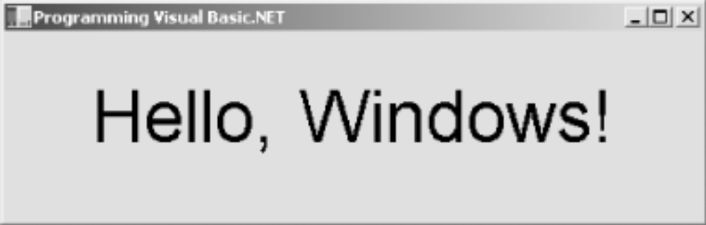
Hello, Windows

Slide 20
Hello, Windows
The possible values of the /target switch are:
exe Creates a console application. The generated file has an extension of .exe. This is the default.
winexe Creates a GUI application. The generated file has an extension of .exe.
library Creates a class library. The generated file has an extension of .dll.

